Slide 1

The Social Responsibilities of Businesses

Slide 2
Shareholder Theory

Slide 3
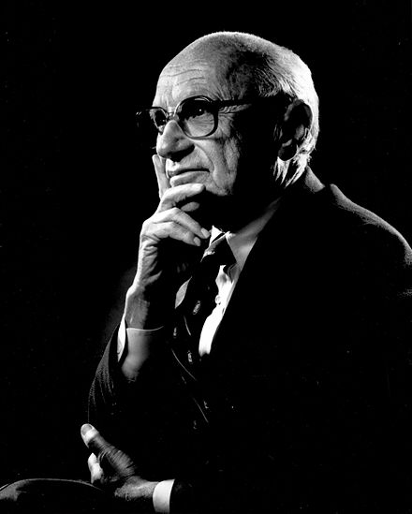
Shareholder Theory
Milton Friedman 1912-2006
Notes:
Shareholder theory is attributed to Milton Friedman, an economist.

Slide 4
Shareholder Theory
Milton Friedman 1912-2006
The only responsibility of business is to maximize shareholder value

Slide 5
Shareholder Theory
A shareholder is someone who owns stock in the corporation

Slide 6
Shareholder Theory
A shareholder is someone who owns stock in the corporation
A business maximizes the value of stock by maximizing profits

Slide 7
Shareholder Theory
“there is one and only one social responsibility of business–to use its resources and engage in activities designed to increase its profits so long as it stays within the rules of the game, which is to say, engages in open and free competition without deception or fraud.”
-Milton Friedman

Slide 8
Shareholder Theory
People have other social responsibilities, but not businesses
Notes:
the corporate executive who makes business decisions is an employee of the shareholders. Therefore, if the executive took action for common social causes, the executive would be giving away someone else’s money. The stockholders or the customers or the employees could separately spend their own money on the particular action if they wished to do so.

Slide 9
Shareholder Theory
People have other social responsibilities, but not businesses
Businesses should not give money to general social interests
Notes:
the corporate executive who makes business decisions is an employee of the shareholders. Therefore, if the executive took action for common social causes, the executive would be giving away someone else’s money. The stockholders or the customers or the employees could separately spend their own money on the particular action if they wished to do so.

Slide 10
The Invisible Hand Argument
A business acting purely for its self-interest will end up promoting the community around it

